Slide 1
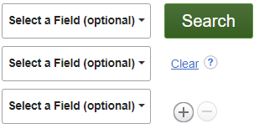

“home design” OR “universal design” OR “housing design” OR architecture OR “architectural design” OR “DOMESTIC architecture”
safe OR supportive OR accessibility OR barrier-free OR “HOME safety” OR “BUILDINGS safety measures”
elder OR “senior citizens” OR seniors OR “older adults” OR aging OR aged OR “ACCESSIBLE design for older people” OR “OLDER people”

Slide 2
aspartame OR Nutrasweet OR “NONNUTRITIVE sweeteners”
women OR female
migraine* OR headache* OR “CLUSTER headache” OR “MIGRAINE prevention”

Slide 3
“social media OR Twitter OR X OR Instagram
asolescen* OR teen*
depression OR “DEPRESSION in adolescence” OR “MENTAL health of high school students”

Slide 4
recessions OR “DEPRESSIONS (Economics)” OR “GREAT Recession, 2008-2013”
housing OR “HOUSE buying” OR “HOME prices” OR “HOME ownership” OR rent
“United States” OR “U.S. States”

